Slide 1

Persona-Driven Document Intelligence
Unlocking Insights from Unstructured PDFs
Presented at the Adobe India Hackathon By Team BinaryBits

Slide 2
Agenda: Your Guide to Document Understanding
01
02
03
Introduction & Problem
PDF Outline Extraction
Document Sectioning
Why traditional PDF parsing falls short for context-rich queries.
Hierarchical analysis of document structure.
Breaking down PDFs into logical content blocks.
04
05
06
Hybrid Ranking
Sub-Section Analysis
The Unified Pipeline
Combining semantic and lexical relevance for superior results.
Extracting the most refined and relevant text snippets.
How all components integrate for powerful insights.
07
Key Takeaways & Q&A
Recap of core concepts and future potential.

Slide 3

The Problem: Lost in a Sea of PDFs
Unstructured Data: PDFs are visual, not easily machine-readable for context.
Keyword Blindness: Simple keyword searches miss nuanced relevance.
Contextual Gaps: How do you find what a "Persona" or "Job-to-be-Done" truly means within a document?
Scalability: Manually sifting through hundreds or thousands of documents is impossible.
Actionable Insights: Raw PDF content doesn't directly provide answers to complex queries.

Slide 4
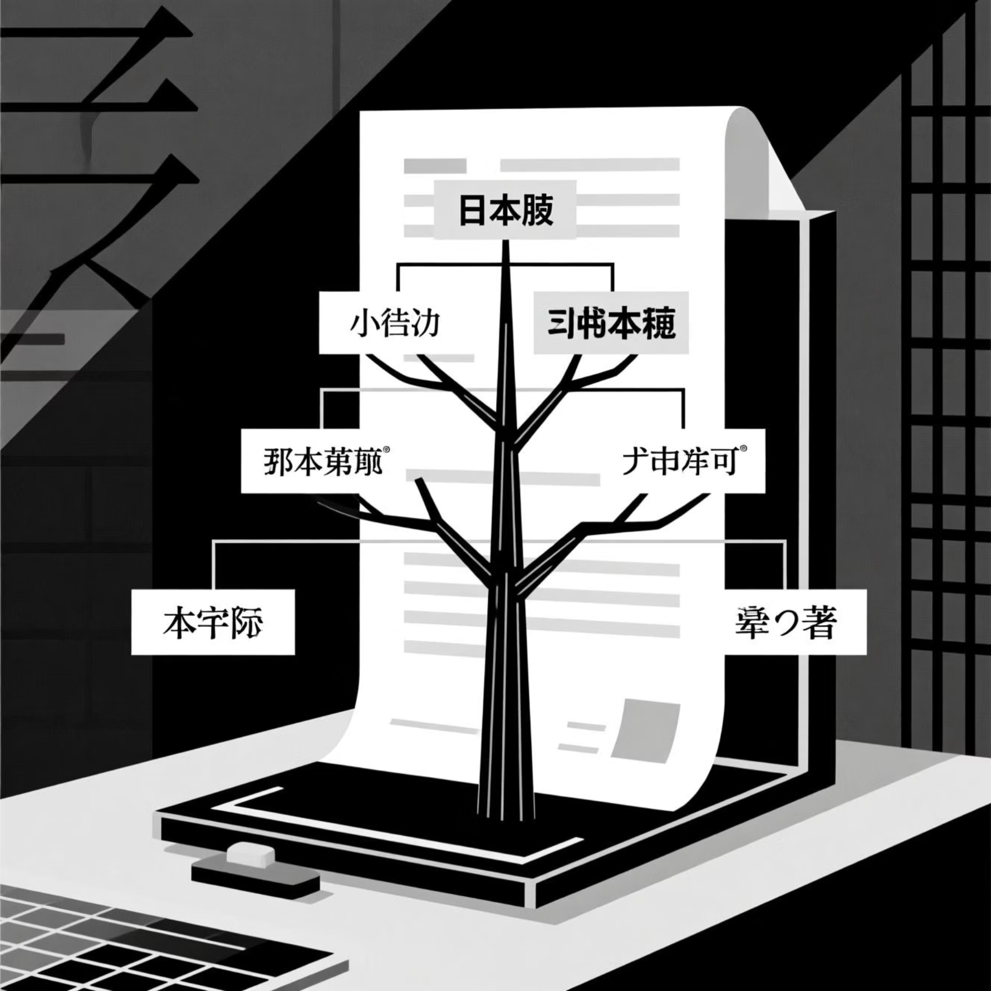
Component 1: PDF Outline Extractor
The PDFOutlineExtractor uses a multi-pass structural analysis to accurately identify headings and build a hierarchical outline.
1
Robust Title Extraction
Goes beyond metadata, analyzing font sizes on the first page to find the most prominent text.
2
Handles Complex Layouts
Distinguishes headings from regular text even when styles are subtle, crucial for diverse PDF formats.
3
Hierarchical Mapping
Assigns H1-H4 levels based on relative font sizes and bolding, creating a navigable document structure.
Key Steps:
Text Block Reconstruction: Identifies individual text blocks with associated styles (font size, bolding).
Body Style Detection: Determines the dominant body text style to differentiate content from headings.
Heuristic-Based Heading Detection: Prioritizes larger, bolded text, and analyzes numbering patterns (e.g., 1.1, 1.1.1) to infer hierarchy (H1, H2, H3, H4).
Metadata Check: Leverages existing PDF Table of Contents (ToC) or metadata titles if available.

Slide 5
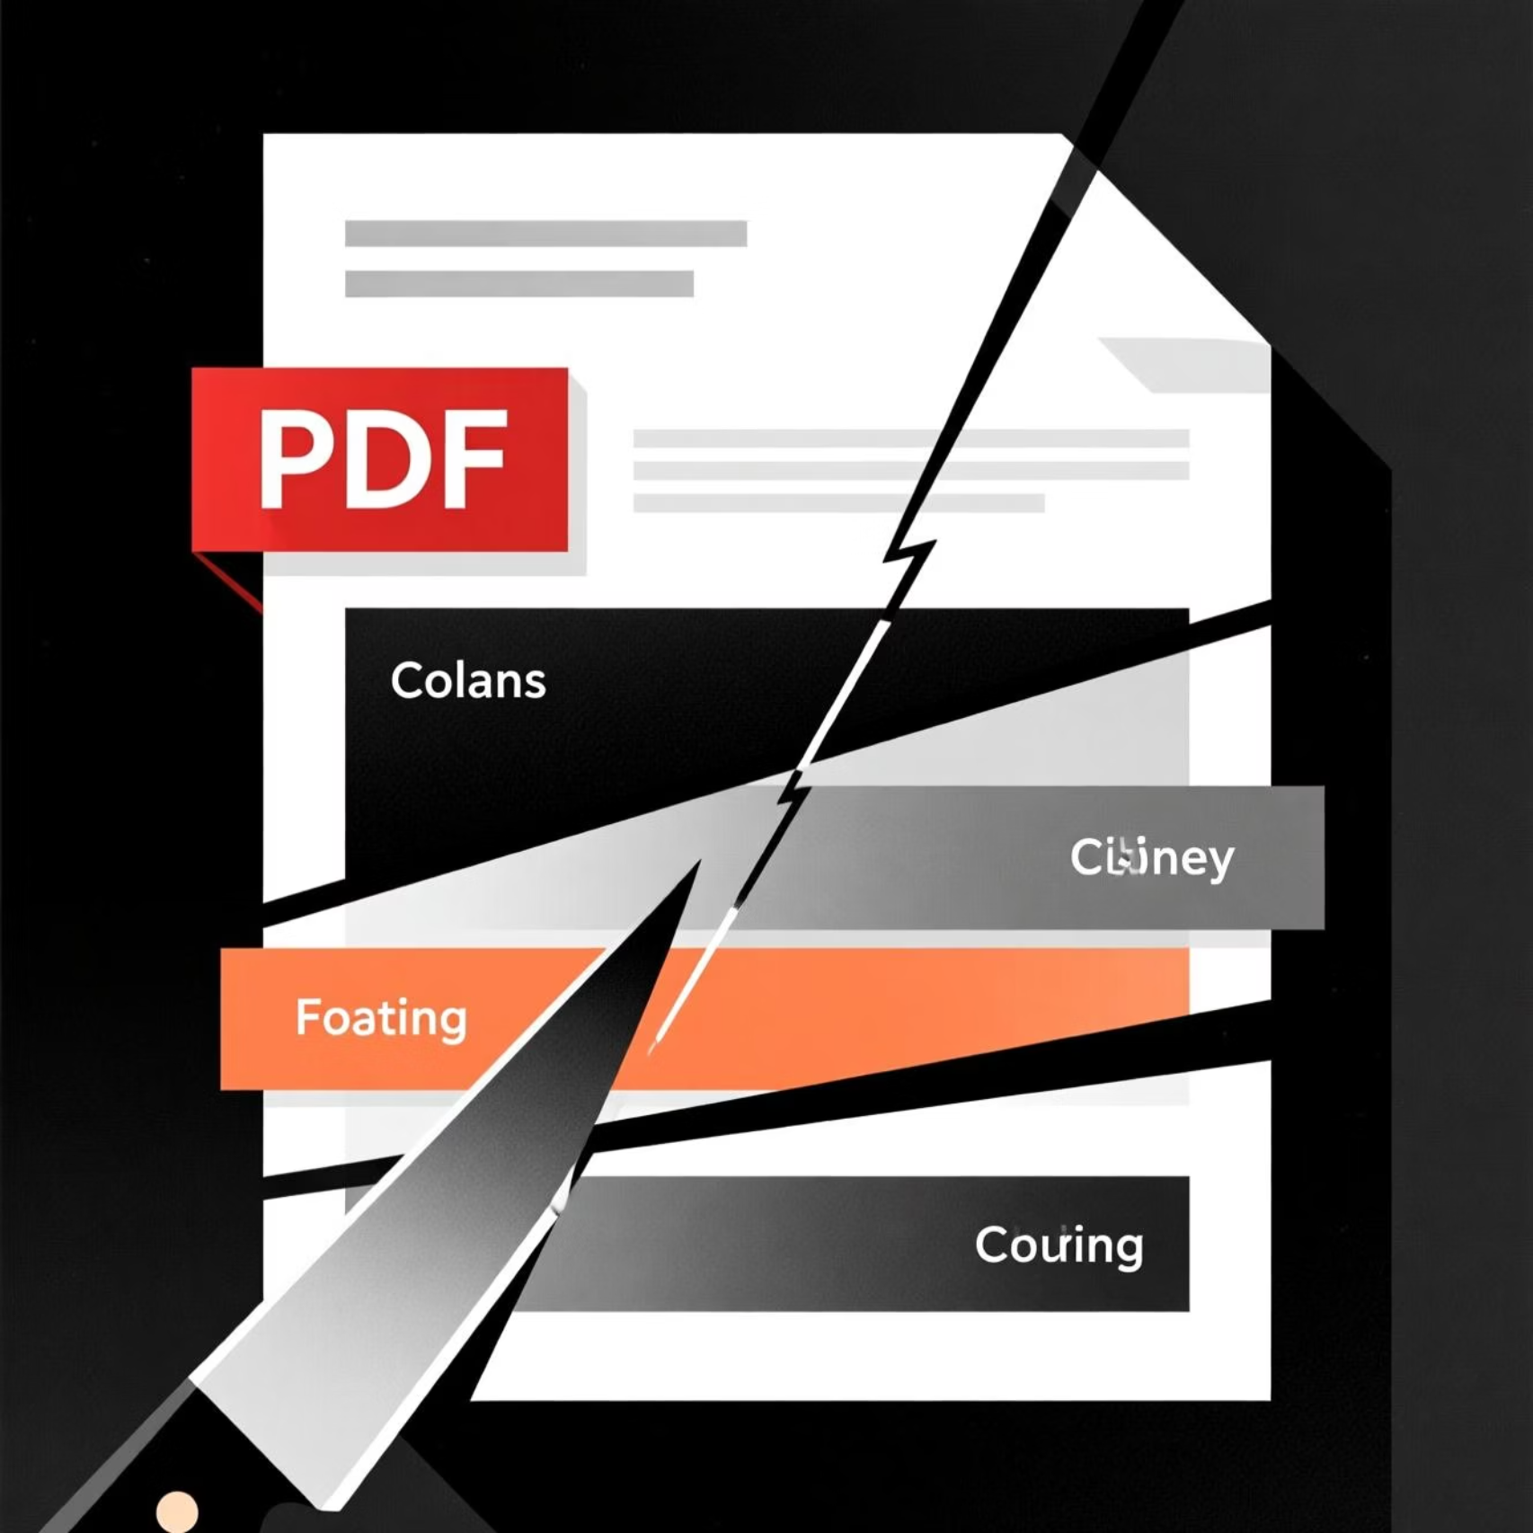
Component 2: Document Sectionizer
Once the outline is built, the DocumentSectionizer uses it to segment the PDF's raw content into meaningful, logical sections.
It iterates through the extracted outline, using each heading's position (page_num and bbox coordinates) to define the start and end of a section's content.
The content for each section is then extracted by clipping the PDF page's text between these defined coordinates. It also cleans up common PDF text extraction artifacts like hyphenation and extra spaces.
This transforms a continuous PDF into discrete, searchable "chapters" or "articles," making subsequent processing much more effective.

Slide 6
Component 3 & 4: Query Processing & Hybrid Ranking
This is where the magic of "persona-driven" relevance truly shines, combining the best of semantic and lexical search.
Query Processor
Hybrid Ranker
Extracts critical keywords from the user's persona and job-to-be-done, forming the lexical part of the query.
Utilizes both Sentence Transformers for semantic understanding and BM25Okapi for keyword matching.
Input: Persona (role), Job-to-be-Done (task).
Semantic Scoring: Uses all-MiniLM-L6-v2 to embed query and section contents, calculating cosine similarity for conceptual relevance.
Process: Concatenates these into a single query string, then extracts keywords by removing stop words and low-frequency terms.
Lexical Scoring: Applies BM25 algorithm to keyword-matched sections, ensuring exact term hits are highly valued.
Output: A list of relevant keywords (e.g., "Python", "NLP", "production", "pipeline").
Normalization: Both scores are normalized to a 0-1 range.
Weighted Fusion: A configurable alpha parameter (default 0.7) combines semantic and lexical scores into a single "hybrid score."

Slide 7
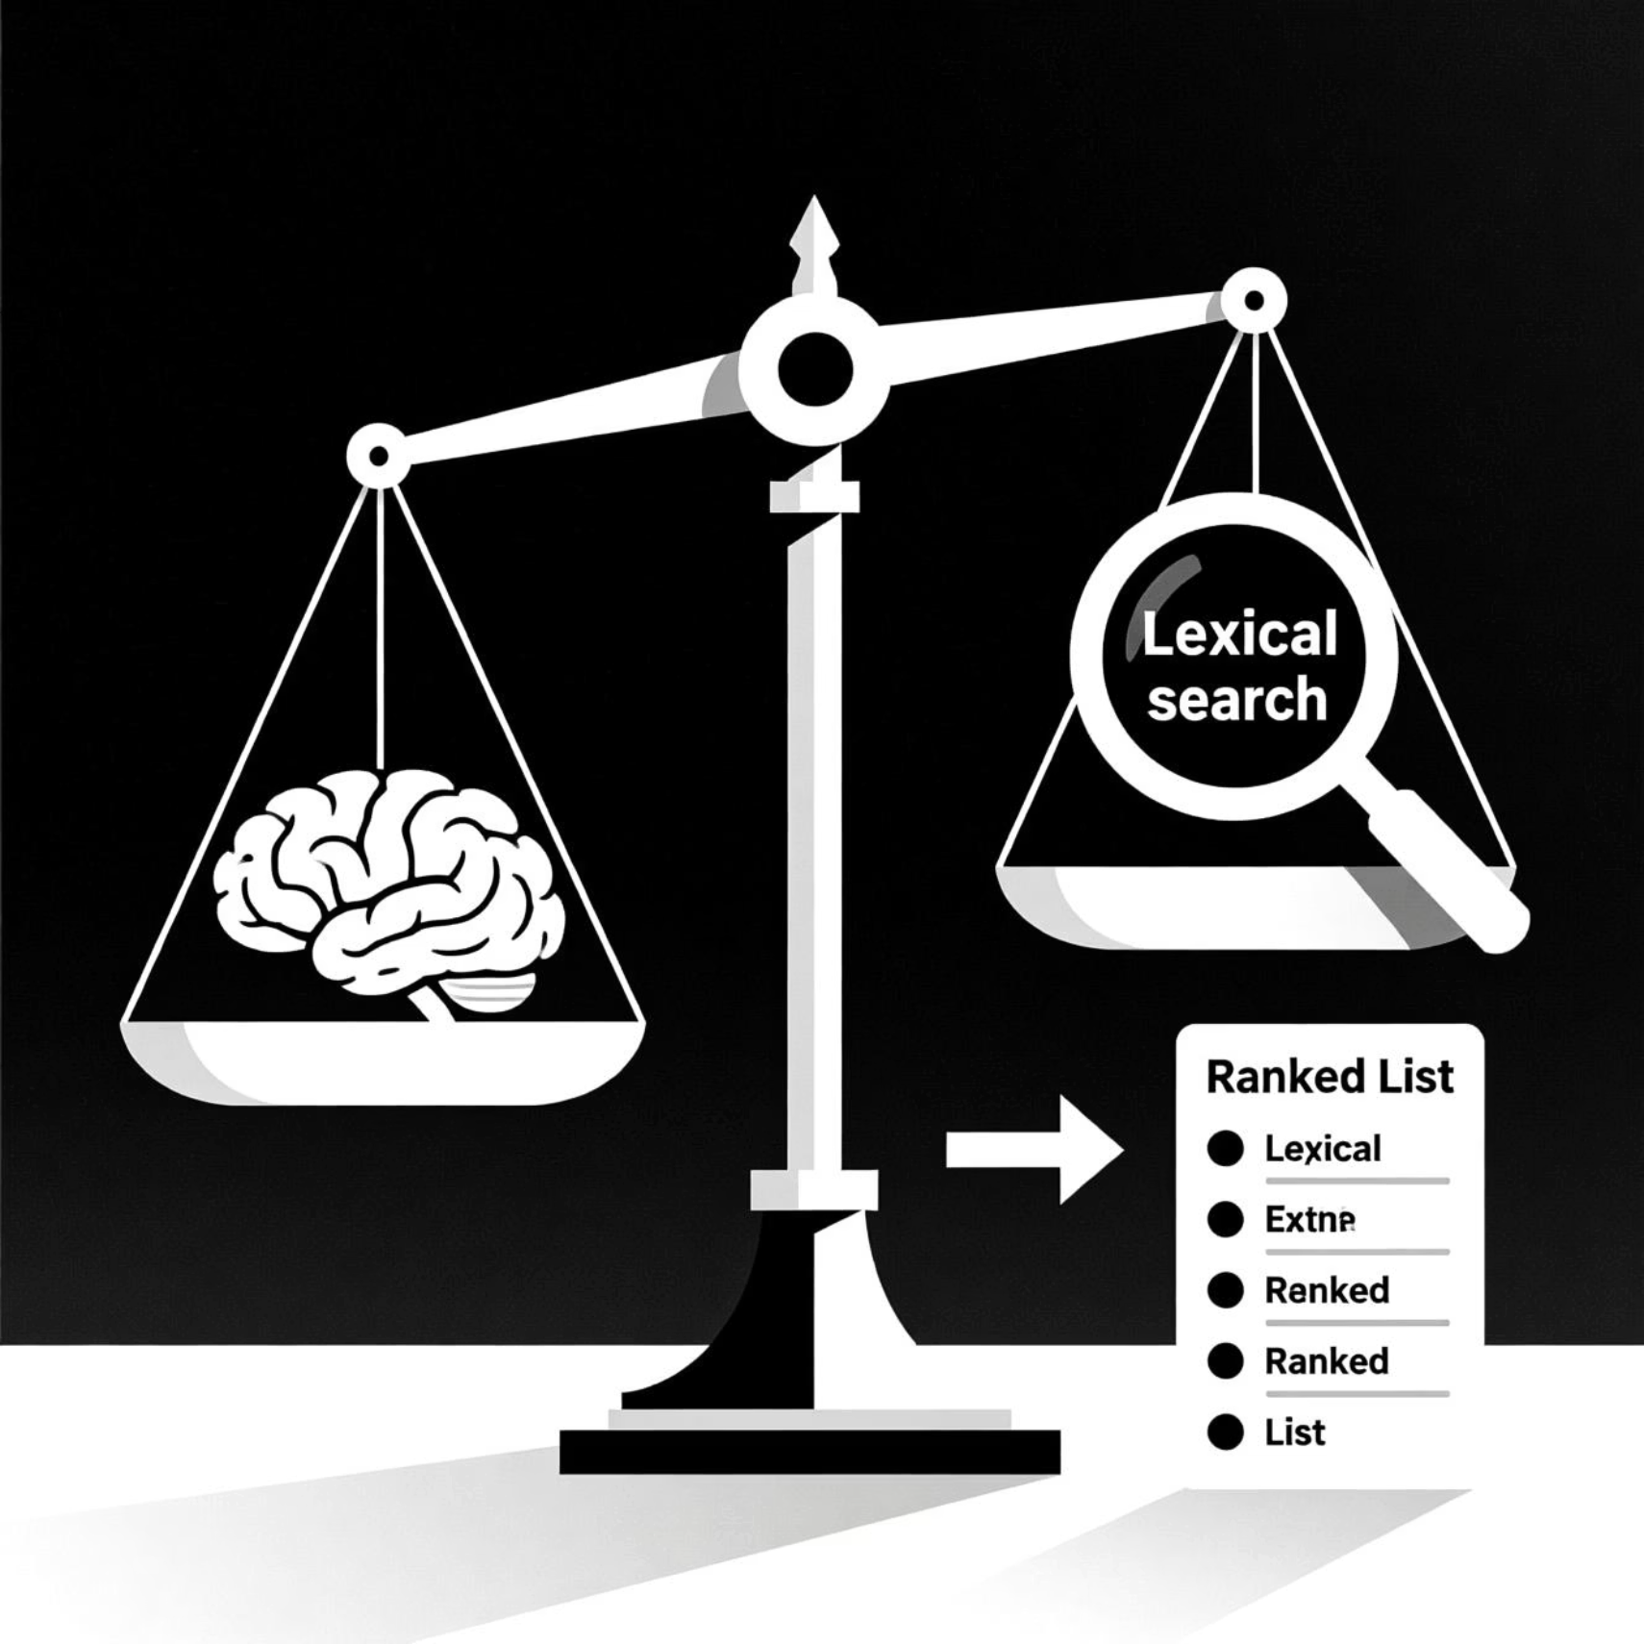

The Hybrid Ranking Formula
Why Hybrid?
Semantic (Conceptual): Captures the meaning, even if exact words aren't present. "Car" and "Automobile" are understood as similar.
Lexical (Keyword): Ensures precise matches are rewarded. Critical for technical terms like "PyMuPDF" or "BM25."
Robustness: Less sensitive to variations in terminology or query phrasing.
Optimized Relevance: Provides a more comprehensive and accurate ranking of sections, directly addressing the user's intent.
Alpha (α): Controls the weighting. α = 0.7 gives more emphasis to semantic similarity, reflecting the value of conceptual understanding.

Slide 8
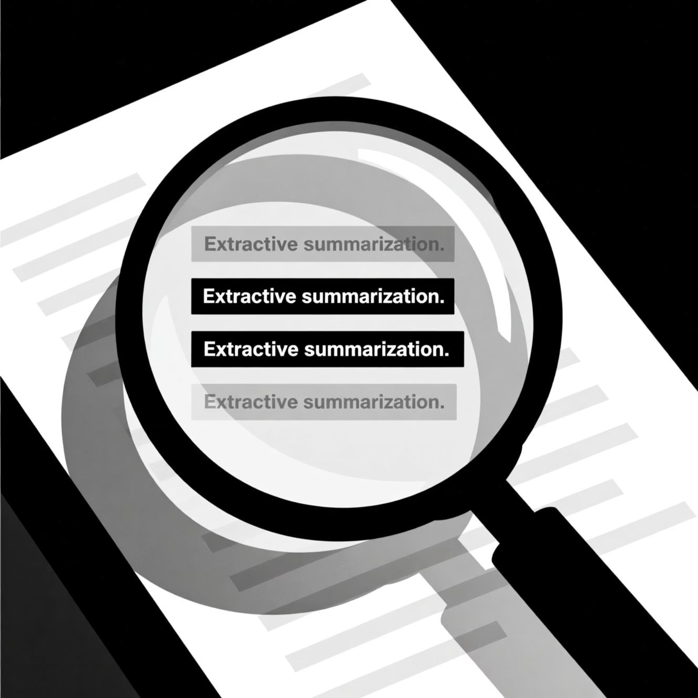
Component 5: Sub-Section Analyzer
Even after ranking, a section can be long. The SubSectionAnalyzer refines the top sections to pinpoint the most relevant sentences.
This component takes a highly ranked section and the original query embedding. It then:
Sentence Tokenization: Breaks down the section content into individual sentences using nltk.sent_tokenize.
Sentence Embedding: Each sentence is embedded using the same Sentence Transformer model used in the Hybrid Ranker.
Similarity Scoring: Calculates cosine similarity between the original query embedding and each sentence embedding.
Extractive Summarization: Selects the top num_sentences (default 5) with the highest similarity scores.
Logical Flow: Sorts the selected sentences back into their original document order to maintain coherence.
The result is a concise, highly relevant text snippet that directly addresses the user's query, avoiding information overload.

Slide 9
The Unified Pipeline: From PDF to Insight
Processing Flow: Documents are ingested, structured, sections ranked based on query, and key snippets extracted.
Output: Top 10 ranked sections (document, title, importance, page) and top 5 sub-section analyses (document, refined text, page).

Slide 10




Key Takeaways & Future Potential
Smarter PDF Parsing
Hybrid Relevance
Moves beyond simple text extraction to intelligent, context-aware document understanding.
Combines lexical precision with semantic understanding for unmatched search accuracy.
Actionable Insights
Production Ready
Delivers refined, concise answers, directly supporting data-driven decisions.
Designed for integration into production pipelines, supporting various NLP tasks.
Q&A: Let's discuss how this can transform your document workflows!

